Slide 1

Project: E-Marching
CSCE 4901 - Team: Nova Elite
Software Development Capstone
Spring 2016
Instructor: David Keathly
Team Leader → Jason Hoang
KaiChuan Chan
Sabrin Thamed
Imran Ahktar

Slide 2
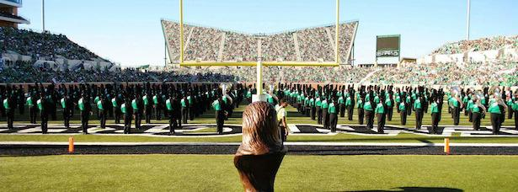
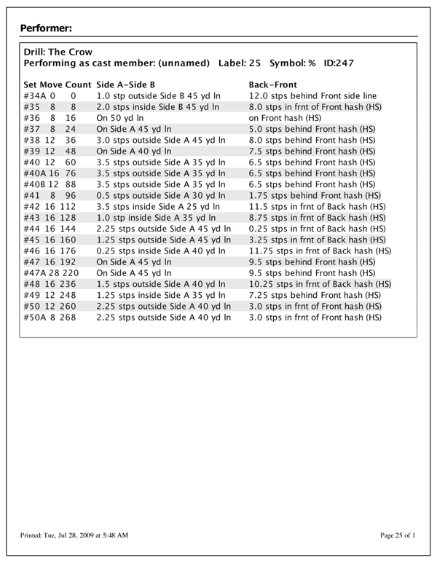
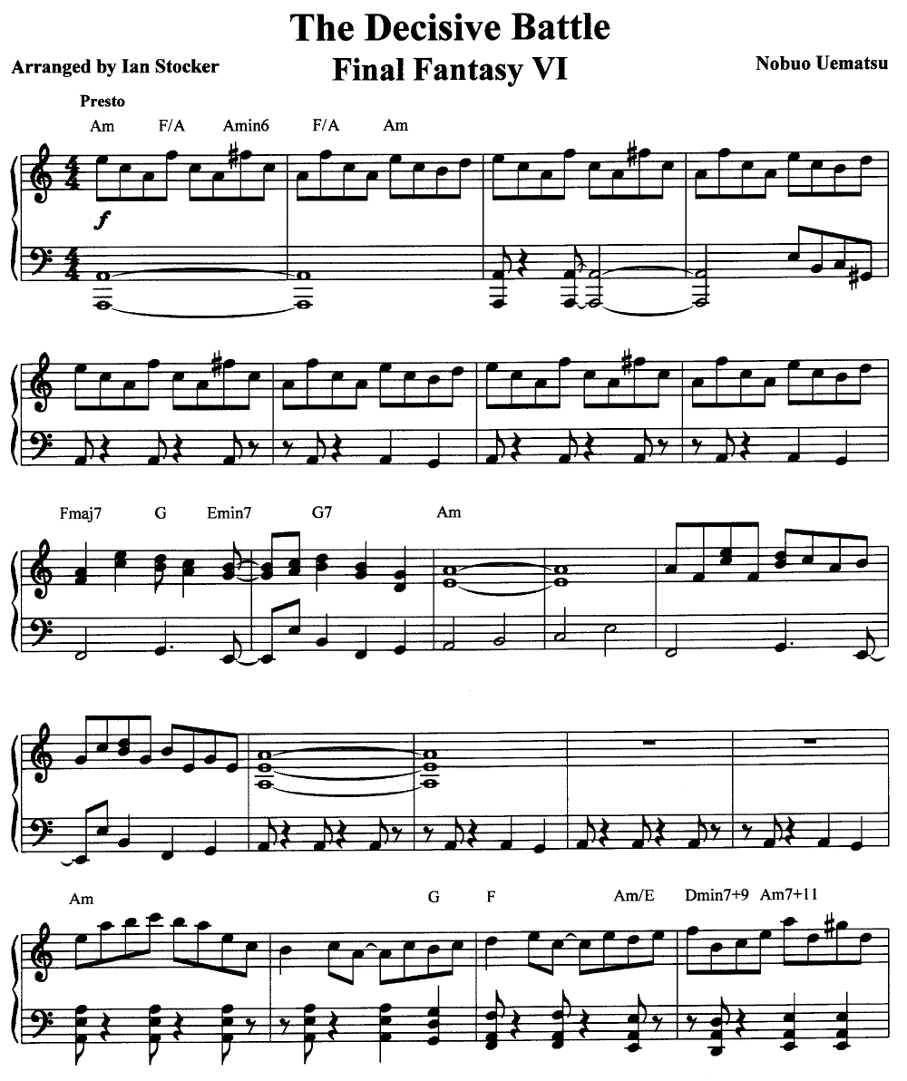
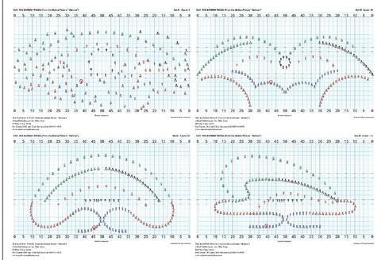
Project Overview
The Marching Band
Teacher App and Student App
Less Paperwork and easier organization
Provide a direct form of communication between the teacher and the student

Slide 3
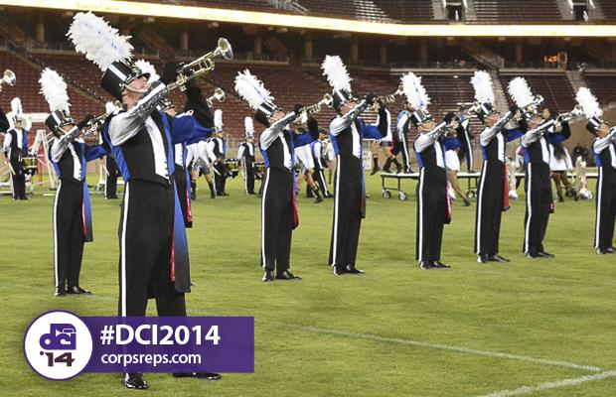
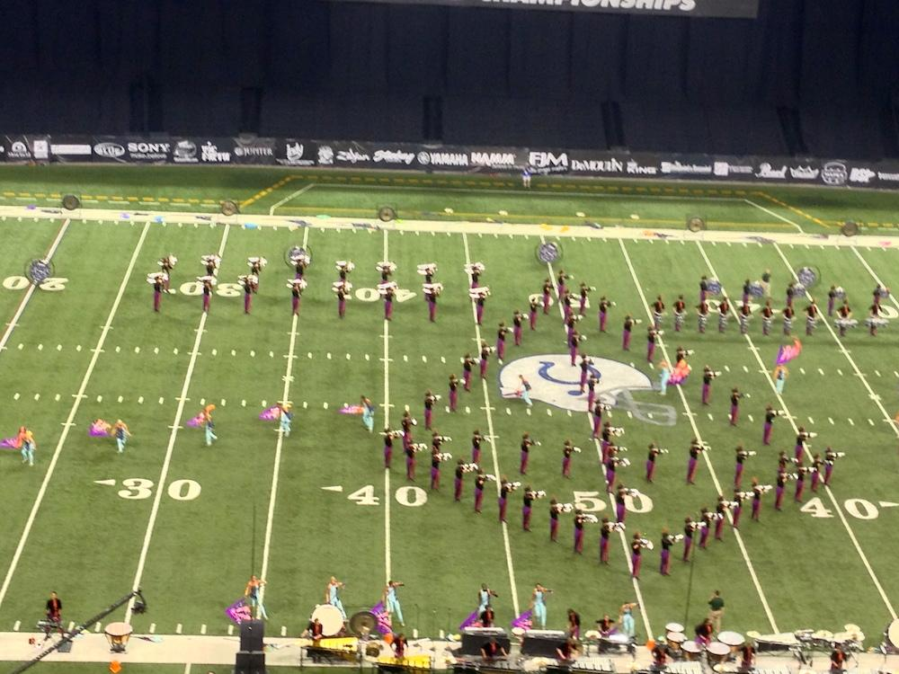
The Client
Texas High School Band Director
Performed in 2 World Class Drum Corps - won the world championship with both groups
Participated on staff with multiple State Level high school marching bands
Graduate from the University of North Texas

Slide 4

The Functional Requirements
Online Database
Login/Logout Authentication
Music Presentation and Editing
Coordinates Presentation and Editing
Notifications - communication between the apps
Menu Bar - Navigation and tools
Attendance

Slide 5

Hardware and Software
Java JDK5 or later version
Android devices
Android Studio 1.5
Android Development Tools (ADT)
Android SDK
Java Runtime Environment (JRE) 6

Slide 6

Problems Encountered/Resolved
Android Studios was a new and unfamiliar coding environment for the team to work with and understand how to use.
Resolution: Utilized the internet to learn more about the IDE and look up tutorials that teach us how to both use and develop applications within Android Studios.
Difficult trying to figure out how to use Android’s SQLite database to store and retrieve images onto and from the device or emulators.
Resolution: Resorted to storing the images on the online database and pulling them onto the device from there.

Slide 7

Lessons Learned
Planning ahead saves a ton of time and work down the road.
Clear and direct communication between team members keeps the project moving forward.
The internet is our best friend.

Slide 8
Work Remaining
Mostly quality of life additions and adjustments such as:
Cleaner interface
Save activity instances when swapping between the music and coordinate pages, so that the user can return to their last active page of that type.
Adding a section to write notes for music pages and coordinate sets.

Slide 9


Future Expansions:
Music Educational Tools
Implementations of MusicXML and Pyware software
More direct communication features between the students and the teachers.

Slide 10
DEMO!

